Slide 1

SIG – 718 Real World Analytics
Mid Term Assessment
Saurabh Dharmadhikari

Slide 2
Contents to cover
ENB data and it’s description
Data scaling using min max method
Scatter plots for each variable with respect to target variable
Histogram for each variable
Box plots
Selecting a sample from our dataset
Scatter plot for selected sample
Fitting functions from AggWaFit718.R
New data points provided.
Predictions on new data points.

Slide 3
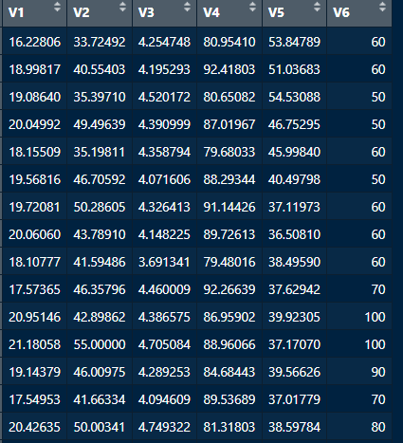
This is the data provided in ENB file extracted in R studio.
We are able to view first few entries here.
Data description:
V1: Temperature in kitchen area, in Celsius
V2: Humidity in kitchen area, given as a percentage
V3: Temperature outside (from weather station), in Celsius
V4: Humidity outside (from weather station), given as a percentage X5: Visibility (from weather station), in km Y: Appliances, energy use, in Wh

Slide 4
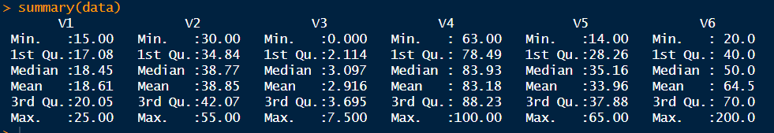
We can see a summary of our data above.
Minimum value in each column.
Maximum value.
And each quartile values.

Slide 5
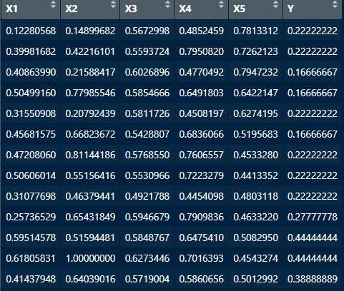
We have now scaled the data.
Min = 0 and max = 1
Also changed column names from V1, V2 ,V3, V4, V5 and V6 to X1, X2, X3, X4, X5 and Y
Y is our target variable.

Slide 6
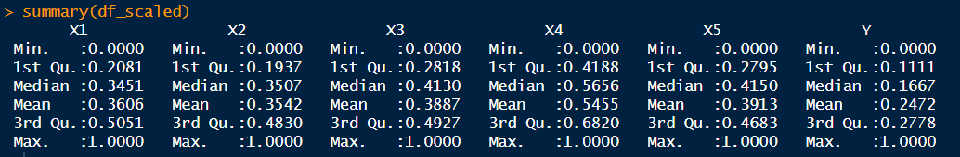
Above is the summary of our scaled data.

Slide 7
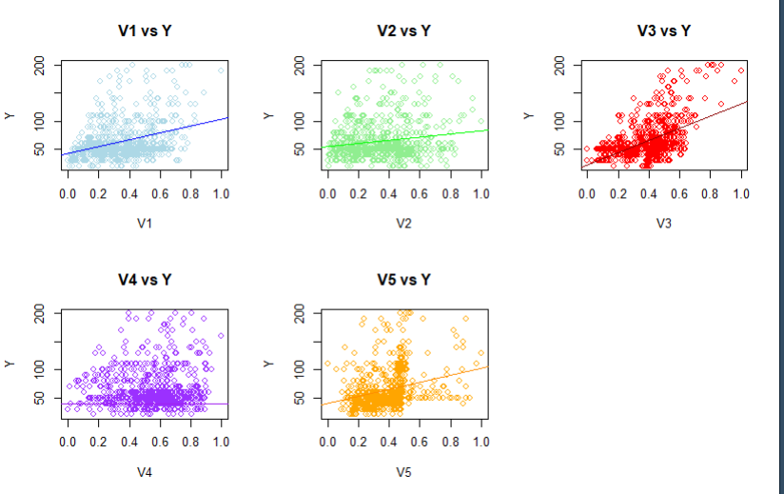
We can see with the scatter plot on our scaled data that there is least relationship between V4 variable and Y.
Other have a positive relation.

Slide 8
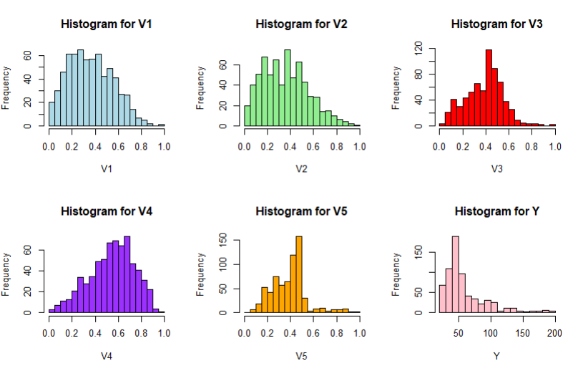
Here with help of histograms we can see that the data is some what normally distributed except for V5.

Slide 9
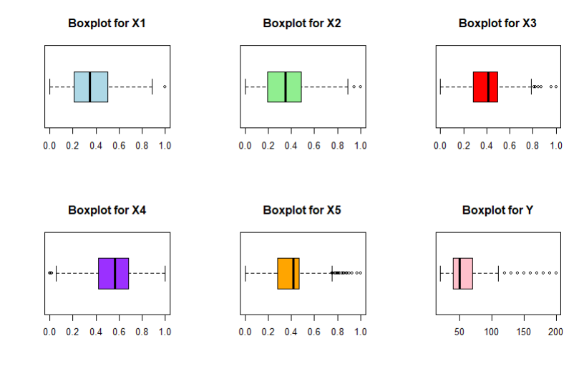
When we observe the box plots we find that they do not have many outliers.

Slide 10
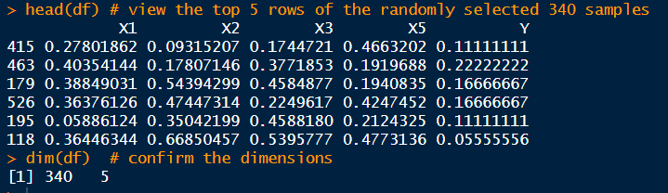
We have now chosen 4 variables. i.e. X1, X2, X3, X5 along with Y as target variable.
We have also taken a sample of 340 entries. Which are randomly chosen.
In the above frame we can see first few entries.

Slide 11
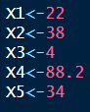
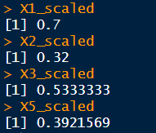
We have been given a new entry and asked to find prediction.
So we scaled the new data.

Slide 12
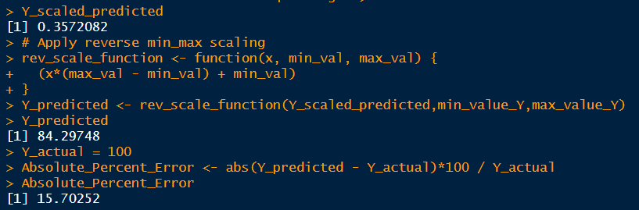
We then made predictions according to the functions we used to build models.
We find that prediction is of about 84.
When we compare the measured value of 100 we find that it is giving us an absolute present error of : 15.70252

